Slide 1
Building the Community Response to the Dolutegravir Safety Signal
Feedback from the Kigali Dolutegravir Stakeholder Meeting of African Women Living with HIV
Jacqueline Wambui, AfroCAB Representative, NEPHAK
Amsterdam, Netherlands| July 26, 2018
IAS

Slide 2
Situation – Background
Botswana Tsepamo study interim results indicated a potential link between neural tube defects (NTD) and dolutegravir (DTG) use at the time of conception.
Global and national stakeholders reacted quickly to the safety signal. The messages and directives in the responses varied, but they all have one thread in common: limited to no community consultation.
This means that we, the global community, did not consult the primary population affected by these findings, the women living with HIV, in regards to their own health care decisions.

Slide 3
Situation – Actions Taken
WHO recommended that countries continue to follow their current guidelines until further updates are available.
Ministries have created interim plans to adapt their HIV treatment guidelines while they wait for more data and guidance.
Some countries are introducing TLD for all first-line patients (with note of caution for women of childbearing age, counseling on contraception, and option of TLE if they choose).
Several countries made highly conservative choices that restrict DTG for all women of child bearing age.
Other countries are still deliberating.
Community consultations were held in some countries but without one clear message from communities the impact on influencing policy decisions was minimal.
Source: WHO Statement 18 May, 2018

Slide 4
Situation – Actions Needed
Urgent need to address this major gap and elevate input from communities before national programs finalize HIV treatment guidelines.
Consensus from the community is needed to inform the decisions made by international and national bodies regarding DTG access for women.

Slide 5
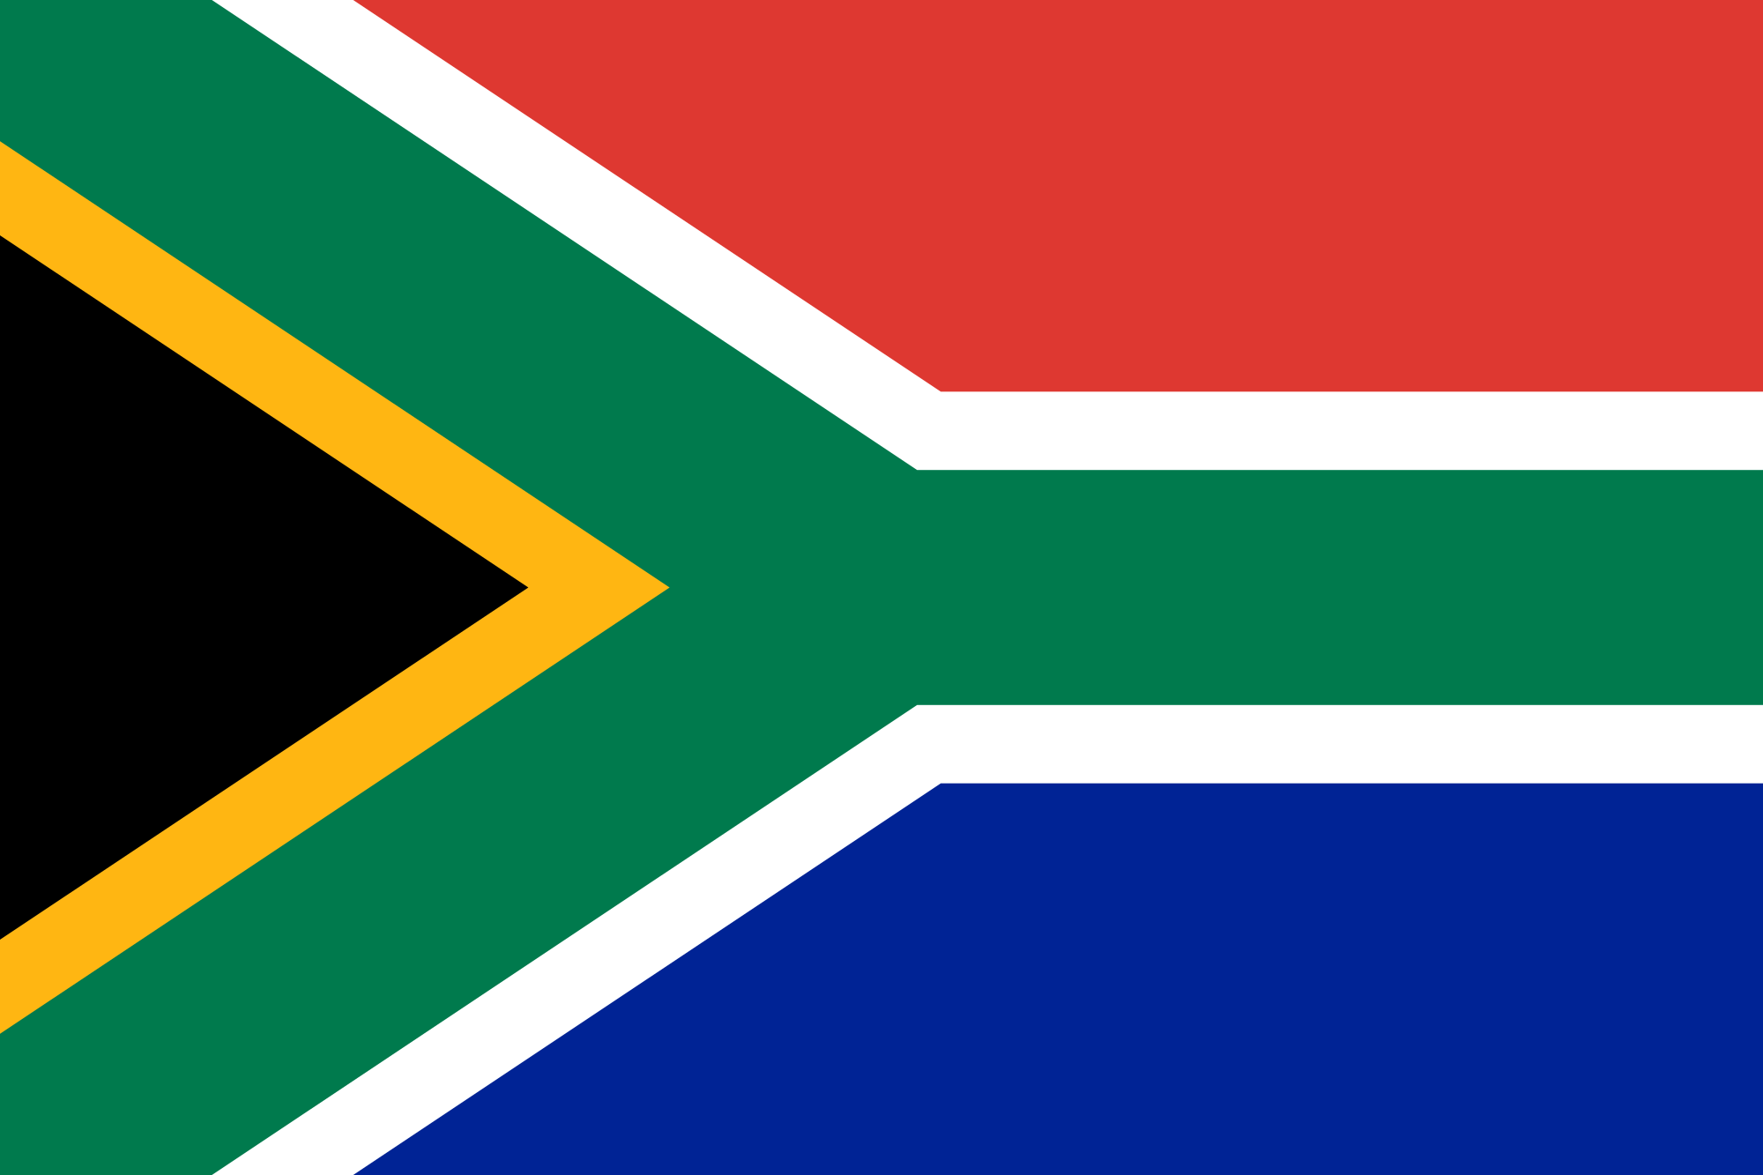
Result - Community Response
AfroCAB organized a meeting of 39 women living with HIV representing 18 countries in Kigali, Rwanda on July 13 and 14 to discuss the potential NTD safety signal and develop a joint position on behalf of women for access to optimal HIV treatment and prevention.
Botswana
Democratic Republic of Congo
Malawi
Rwanda
Swaziland
Uganda
Burundi
Ivory Coast
Mozambique
Senegal
Tanzania
Zambia
Cameroon
Kenya
Nigeria
South Africa
Togo
Zimbabwe

Slide 6
Meeting Participants – Global and National Stakeholders
Presentations from normative bodies, national programs, and implementing partners presented the current global landscape and considerations following the neural tube defect safety signal.
A panel of women initiated on DTG provided their experiences –which were overwhelming positive – since starting their new treatment.
Feedback sessions from community consultation meetings in Malawi, Uganda, and Kenya shared successes and challenges with country engagement and advocacy.

Slide 7
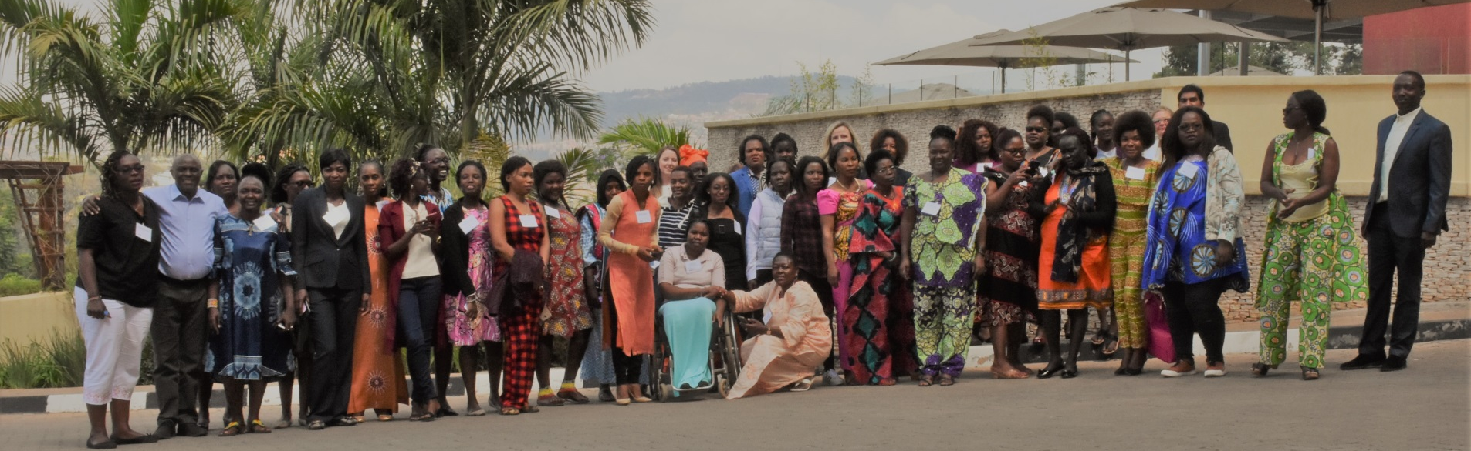
Topline Message
Unanimous decision based on the data currently available that DTG’s benefits – reduced side effects, improved efficacy, and a high barrier to resistance – outweigh its potential risks.
Concluded that blanket exclusions that deny women equitable access to this optimal HIV treatment are not warranted or justified.

Slide 8
Discussion – Benefits
The benefits of DTG have been well documented and studied. An IAS presentation by CEPHAC earlier this week provided further analysis on the potential benefits of DTG over EFV. The following are key findings presented:
Dolutegravir-based ART would avert >25,000 deaths among women of childbearing age and 5,000 pediatric HIV infections compared to efavirenz-based ART over a five-year period in South Africa
These benefits may come at the expense of overall pediatric survival if the increased risk of NTDS with DTG from Tsepamo persists with additional data.
However, there would be approximately 3-fold more deaths averted among women than pediatric deaths added with use of DTG for all women of childbearing age with HIV in South Africa.
Source: CEPHAC. IAS 2018
Notes:
I looked but the slides from this presentation weren’t available on the conference website, but there were also benefits in terms of reduced horizontal infections from DTG use

Slide 9
Discussion – Side Effects
All ARVs have associated risks of side effects, including adverse birth outcomes.
Risks associated with EFV use must be recognized and factored into evaluation of risks and benefits, just as the potential risk of adverse birth outcomes for women on DTG must be weighed against its benefits.
Any adverse
birth outcome
Severe adverse birth outcome
HIV-uninfected (N=34,616) | EFV/ TDF/FTC (N=2,503) | NVP/ TDF/FTC (N=775) | NVP/ ZDV/3TC (1,403) | LPV-r / TDF/FTC (N=237) | LPV-r/ZDV/3TC (N=169)
Source: Zash R. 9thIAS Conference Abstract MOAX0202LB

Slide 10
Discussion – Patient Experience
“On TLE, I felt dizzy, tired, couldn’t work, and couldn’t take care of my small kids properly. It’s been one month since I started using it [DTG]. It’s a big change. I’m active, my kids are happy because they have an active mother, and I can do my work without depending on anybody.”
– meeting participant on DTG

Slide 11
Discussion - Challenges
Moving to TLD while maintaining tenofovir-lamivudine-efavirenz/tenofovir-emtricitabine-efavirenz (TLE/TEE) in the system is complex.
However, supply chain systems currently manage multiple regimens for second-line and toxicity and it was always known that TB and pregnancy could be an issue.
National programmes will face challenges, but we can work together to overcome them.

Slide 12
Key Takeaways – Voices of WLHIV
Potential risk similar to the other ARV treatments that are currently available to us.
We are diverse – not all women seek to have children.
We can make decisions about our reproductive health.
We are disappointed at our lack of involvement in decision making in regards to our treatment access.
We believe that, with correct information and contraceptive access, we can make informed choices in using DTG and planning our pregnancy.
This is an opportunity for integrating much-needed access to contraceptives within HIV treatment in order to achieve universal reproductive health care for all.

Slide 13
Recommendations – Policymakers, Stakeholders & Governments
Do not deny us, WLHIV, access to DTG regardless of our childbearing potential.
Include us in research studies and clinical trials.
1
5
Strengthen HIV and SRH services to ensure access to DTG together with acceptable, available, affordable and accessible contraception.
Better integrate HIV, sexual and reproductive health (SRH), and other treatment support services.
2
6
Clearly communicate the short and long-term side effects of ARVs to enable us to make informed decisions.
Do not force WLHIV to take a particular medication.
7
3
Involve us, the WLHIV, in local, national, and global discussions and decisions regarding HIV treatment options.
Strengthen surveillance systems in order to detect any and all potential risk and harm due to use of ARVs.
4
8

Slide 14
Act Now
We are calling for TLD to be made available urgently across Africa, with everyone having access, regardless of gender or reproductive capability, and with integration of sexual and reproductive health services.
It is critical to not just view a pregnant mother, or any woman of childbearing potential, as a vessel for a baby, but as an individual in her own right, who deserves access to the very best, evidence-based treatment available and the right to be adequately informed to make a choice that she feels is best for her.

Slide 15
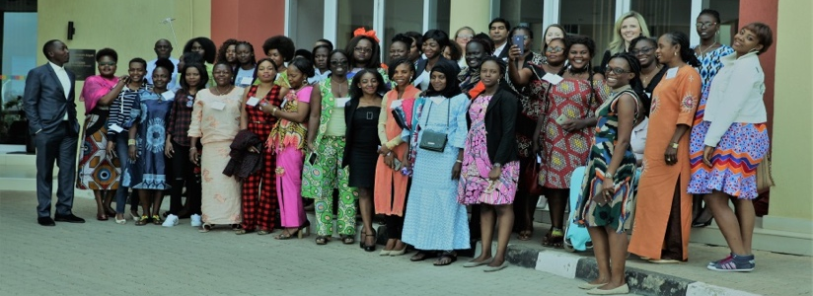
Thank You
NOTHING FOR US WITHOUT US.

